Slide 1

Globalization, glocalization, slowbalization
^{Market Entry}
HBP# FO0014

Slide 2
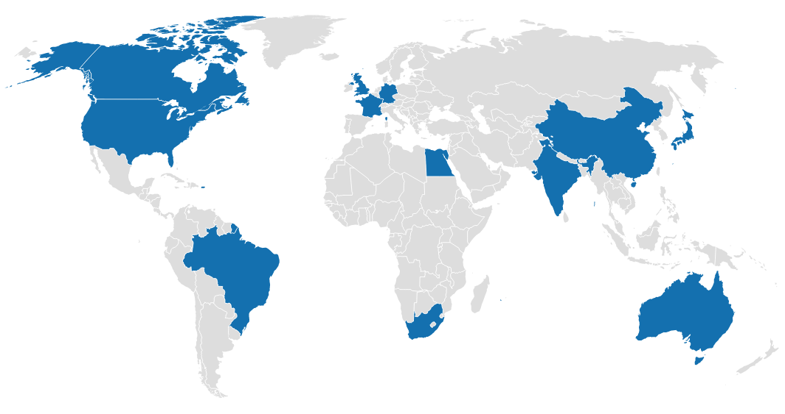
International Business Simulation: Market Entry - Overview
In the Market Entry simulation, you are in charge of managing the international strategy and operations of a casual dining chain of restaurants for 6 years.
You manage all of the company’s business outside your home country.
After choosing a home country, review the country information and news for the year before making decisions on:
Countries to enter, grow or exit
Entry Modes
Local Marketing decisions

Slide 3
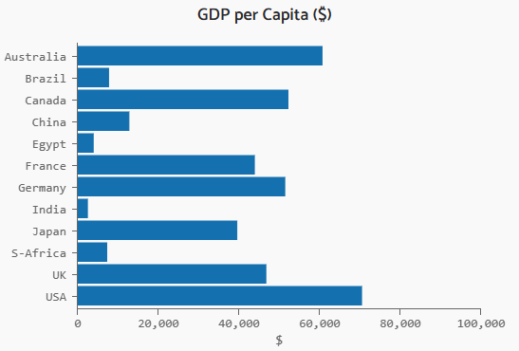
Country Info: GDP and Population
Gross Domestic Product (GDP) per Capita is a measure of the income level of people in the country.
GDP forecast is indicator of expected market growth. Based on data from the International Monetary Fund.
GDP per capita, GDP growth and population growth are indicators of market attractiveness in the family restaurant market.

Slide 4

Country Info: Market Characteristics
Country Risk:
A broad measure that indicates risks arising from economic or political changes or general instability in a country.
Trade Barriers (tariffs):
Impact the cost of importing ingredients from the home country.
Industry Rivalry:
The intensity of competition in a market.

Slide 5

Country Info: Culture
Culture can be defined as ‘the set of shared beliefs, values and other norms that distinguish one group of people form another’.
Geert Hofstede developed a framework that summarizes cultures along six dimensions:
Power Distance
Individualism
Masculinity vs Femineity
Uncertainty Avoidance
Long Term Orientation
Indulgence
In the simulation, Cultural Distance between two countries is calculated based on the sum of the differences in scores on each of the dimensions of culture.
Indulgence reflects the extent to which a society values the satisfaction of human needs and desires.
In the simulation, countries with a high Indulgence score are more attractive.

Slide 6

Cultural awareness and cultural shock
Geert Hofstede, a Dutch interculturalist, is one of the most noted academicians to explore this subject
From 1967 until 1973 as an IBM psychologist, Hofstede collected and analyzed data from over 100,000 individuals from over 50 countries
From those results and later additions, Hofstede developed a model that identifies four primary dimensions to differentiate cultures. He later added a fifth dimension.

Slide 7
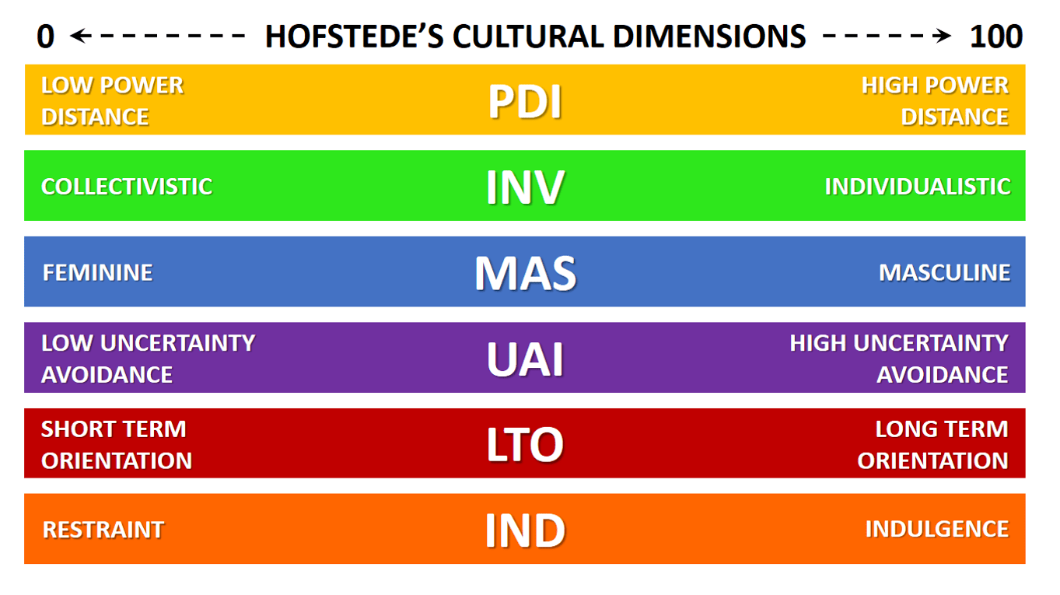
Cultural awareness and cultural shock

Slide 8
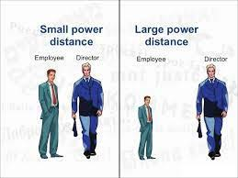
Cultural awareness and cultural shock
Power Distance Index (high versus low)
This dimension explains the extent to which members who
are less powerful in a society accept and also expect that the
distribution of power takes place unequally

Slide 9
Cultural awareness and cultural shock
High vs. Low power distance
1) More powerful members of society perceive their subordinates as unequal
3) Members accept power distance as part of a social order, it determines what is right and wrong
9) Subordinates are considered as older, more experienced colleagues
4) There is not much trust among co-workers
2) People are equal, they consider social inequalities obsolete (borders, politics)
6) Subordinates fear the more powerful members
8) Subordinates are blamed for mistakes
5) Everyone should have equal rights
11) The acceptance of the privileges that come with power
7) Power is exerted only where it is necessary
10) The system is blamed for mistakes

Slide 10
Cultural awareness and cultural shock
High vs. Low power distance
Features of high power distances cultures | Features of low power distances cultures
Members accept power distance as part of a social order, it determines what is right and wrong | Power is exerted only where it is necessary
More powerful members of society perceive their subordinates as unequal | People are equal, they consider social inequalities obsolete (borders, politics)
Subordinates fear the more powerful members | Cooperation should be based on the principle of solidarity
There is not much trust among co-workers | Subordinates are considered as older, more experienced colleagues
Majority of people are dependent on others | Co-workers are prone to trust one another
Subordinates are blamed for mistakes | The system is blamed for mistakes
Social inequalities are accepted, every person has a high or low place in a social order and is protected by law | Everyone should have equal rights
The acceptance of the privileges that come with power | Strong and weak members coexist in harmony and in the same place

Slide 11
Cultural awareness and cultural shock
Intercultural ignorance strikes and many are affected in their daily functions. No young expatriate or executive can ignore these barriers, they are real, present, and part of everyday life.

Slide 12
Intercultural trainingining
Companies with the help of international human resources will reduce the risk with intercultural intelligence
training
•
Period of time
Training methods
internship
Student exchanges
Young professional program
Level of knowledge
Study case
Cultural feelings
Cultural awareness
Books
Lecture
Easy
Complex
School
Academic
Analytic
Professional

Slide 13
Cultural awareness and cultural shock
Culture shock is a common phenomenon and, though it may take months to develop, it often affects travelers and people living far from home in unexpected ways
Culture shock generally moves through four different phases: Euphoria, Culture shock, Acculturation and Stable state

Slide 14
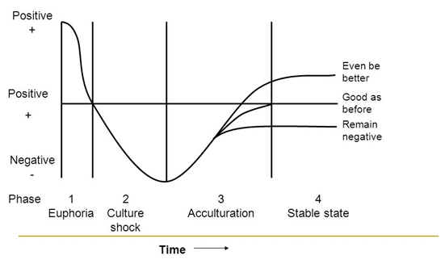
Cultural awareness and cultural shock
The Acculturation Curve. Original Hofstede model of Acculturation

Slide 15
Cultural awareness and cultural shock
Cultural empathy
Test….
Cultural empathy makes for a more peaceful world, as culturally empathetic individuals are more tolerant of differences in others.
Cultural empathy is simply having an appreciation and consideration of the differences and similarities of another culture in comparison to one's own.

Slide 16
Nation Concept
Nation is a point of Reference
Companies = People
Within the Culture there are behavioral practices, which can affect companies:
Group affiliation. Especially in more closed and less egalitarian cultures.
Groups by Gender. Certain cultures preferences for a particular gender
Age groups. Age as positive/negative point according to culture
Groups by Family. Based on a theme of trust, e.g. Southern Italy
Requirements Hierarchy. Hofstede dimensions may be different by culture
Languages
The basic similarity amongst people within countries is both a cause and an effect of national boundaries.
National identity is perpetuated through the rites and symbols of a country and a common perception of history.
.

Slide 17
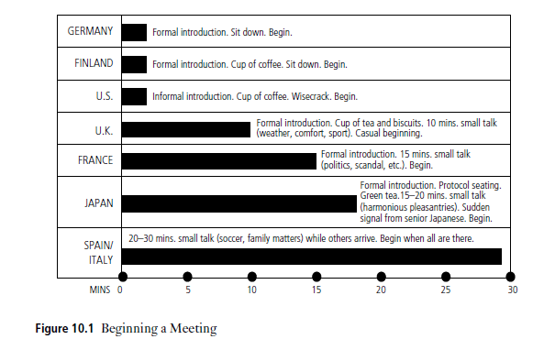
ICustoms and Traditions

Slide 18
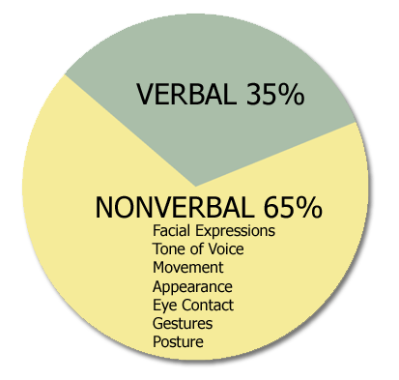
IV Verbal and non-verbal language
Studies have shown that in the process of communication, non-verbal expression has 65% to 93% more influence than actual text. This means that "how to say" is more important than "what to say".

Slide 19
IV Verbal and non-verbal language
Employers and professors love motivated employees / students
Communicating your motivation levels
what is said;
how it is said;
verbal language
body language
Asking a ‘team player’ question
What makes you a good team player?
How do you find working in a team?
Do you prefer working alone or in a team? Why?
What do you dislike about working in a team?

Slide 20
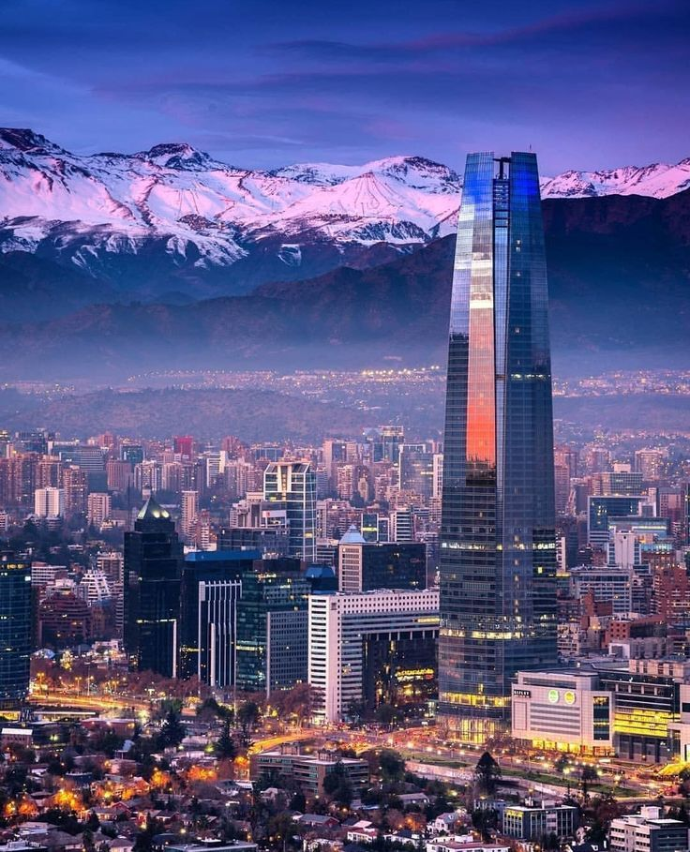
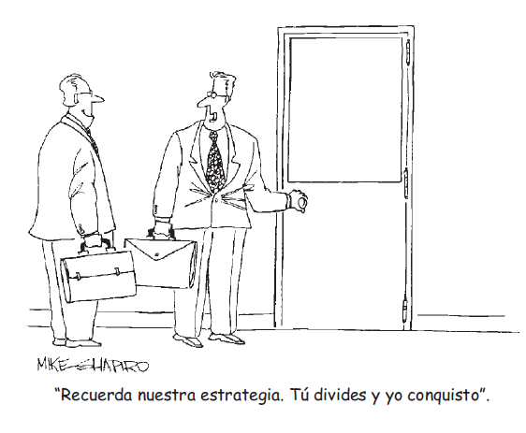
Behavioral practices that affect business

Slide 21

Religion
Religion as a cultural stabilizer
Religion is a major source of both cultural imperatives and cultural taboos.
Major religions include:
- Buddhism 530 mill
- Christianity 2,400 millones de personas
- Hinduism 1,200 mill
- Islam 1,900 mill
- Judaism 16 mill

Slide 22
CONCLUSION
Host cultures do not always expect firms and individuals to conform
to their norms; in some instances, they may choose to
accommodate differences in traditions.
International firms should make a concerted effort to identify ideas
and behaviors in host countries and foreign cultures that can be usefully applied across the whole of their organizations.
Notes:
Latinos is a bit pejorative

